Slide 1
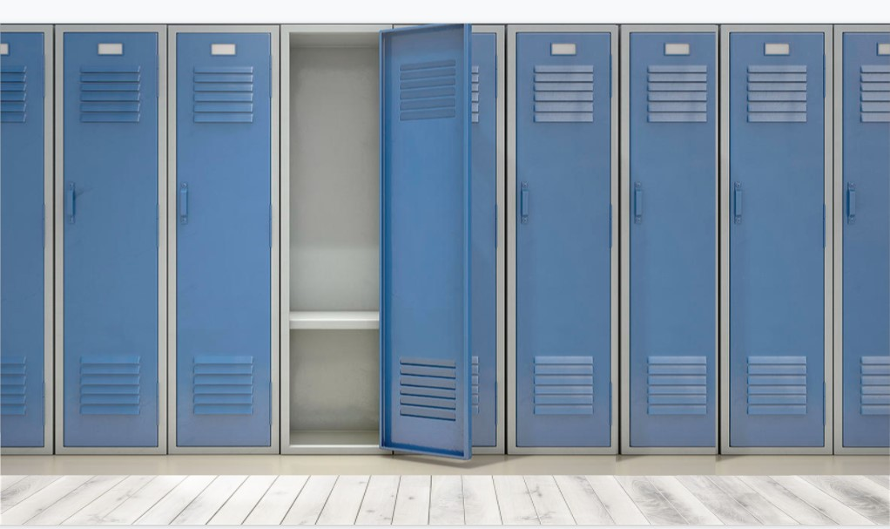
Directions to get started...
Login to your own Google Drive account to save a copy of this file.
Click on “File”
“Make a Copy”
Save a copy to your own Google Drive or download it to your desktop
Create & edit your own locker or cubby
Delete thess textboxes and add your own images & text
Have fun!
WELCOME to Mrs. Ruiz-Houston’s class!
To get to know each of your, we’re all going to create virtual lockers or cubbies filled with our favorite things.
Include at least 10 (or more!) things that tell about who you are.
Consider including some of the following:
Your preferred name (or nickname)
pictures of family/friends/pets
your favorite book(s)
your favorite movie(s)
your favorite tv show(s)
your favorite music
what you like to do for fun
a future goal you have
your favorite sport and/or team
your favorite food
your favorite subject to learn about
a hobby you enjoy
a college you are interested in attending
a place you’d like to visit
something you did over the summer
be creative!
You can choose to present your locker to the class or write a short summary to tell me why you chose to include the things you did.

Slide 2
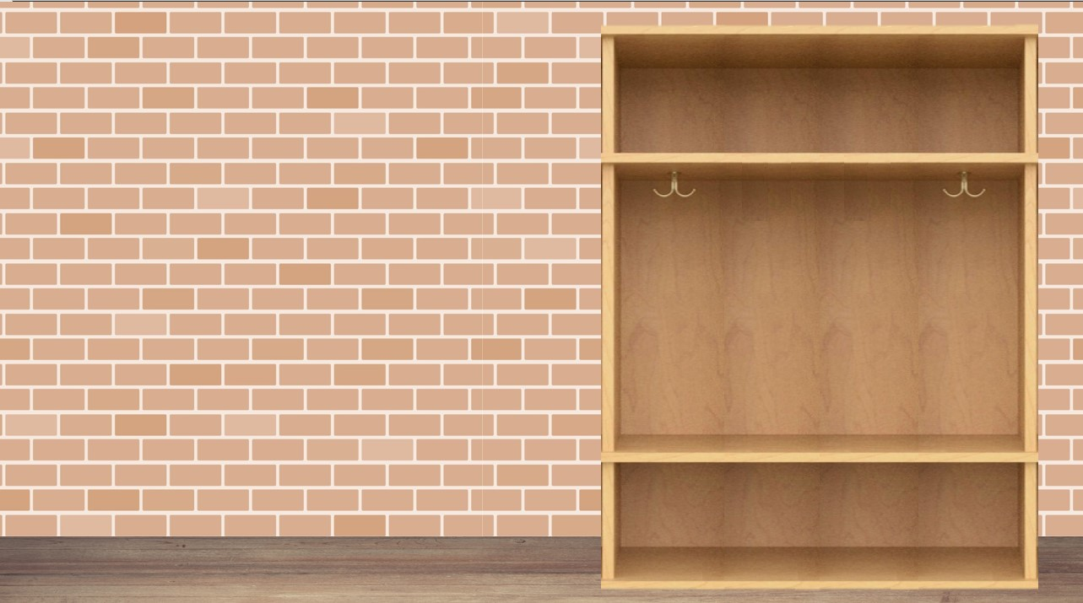
Directions to get started...
Login to your own Google Drive account to save a copy of this file.
Click on “File”
“Make a Copy”
Save a copy to your own Google Drive or download it to your desktop
Create & edit your own locker or cubby
Delete thess textboxes and add your own images & text
Have fun!
WELCOME to Mrs. Ruiz-Houston’s class!
To get to know each of your, we’re all going to create virtual lockers or cubbies filled with our favorite things.
Include at least 10 (or more!) things that tell about who you are.
Consider including some of the following:
Your preferred name (or nickname)
pictures of family/friends/pets
your favorite book(s)
your favorite movie(s)
your favorite tv show(s)
your favorite music
what you like to do for fun
a future goal you have
your favorite sport and/or team
your favorite food
your favorite subject to learn about
a hobby you enjoy
a college you are interested in attending
a place you’d like to visit
something you did over the summer
be creative!
You can choose to present your locker to the class or write a short summary to tell me why you chose to include the things you did.

Slide 3
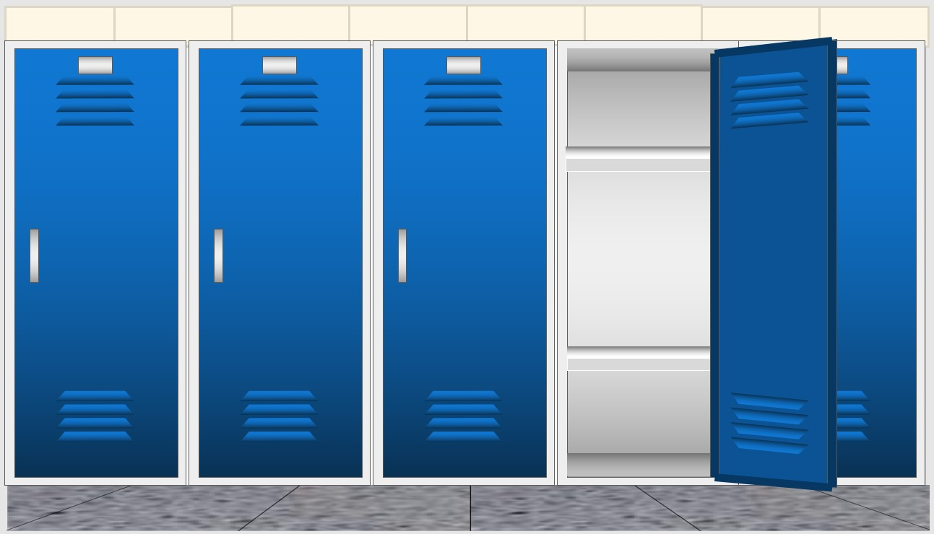
Directions to get started...
Login to your own Google Drive account to save a copy of this file.
Click on “File”
“Make a Copy”
Save a copy to your own Google Drive or download it to your desktop
Create & edit your own locker or cubby
Delete thess textboxes and add your own images & text
Have fun!
WELCOME to Mrs. Ruiz-Houston’s class!
To get to know each of your, we’re all going to create virtual lockers or cubbies filled with our favorite things.
Include at least 10 (or more!) things that tell about who you are.
Consider including some of the following:
Your preferred name (or nickname)
pictures of family/friends/pets
your favorite book(s)
your favorite movie(s)
your favorite tv show(s)
your favorite music
what you like to do for fun
a future goal you have
your favorite sport and/or team
your favorite food
your favorite subject to learn about
a hobby you enjoy
a college you are interested in attending
a place you’d like to visit
something you did over the summer
be creative!
You can choose to present your locker to the class or write a short summary to tell me why you chose to include the things you did.

